Slide 1
CPSC331 - Spring 2019 Tutorial 13
Khobaib Zaamout

Slide 2
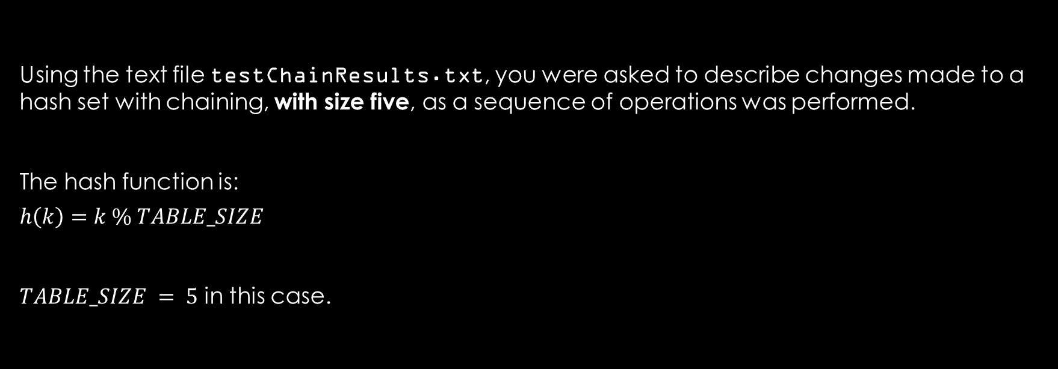
Q1: Describe changes to hash set
Using the text file testChainResults.txt, you were asked to describe changes made to a hash set with chaining, with size five, as a sequence of operations was performed.
The hash function is:
$$h\left(k\right)=k \% TABLE_SIZE$$
$TABLE_SIZE = 5$ in this case.

Slide 3
Q1: Describe changes to hash set
Operations:
>Create a hash table with size 5_
Work Area:
Hash Set:

Slide 4
Q1: Describe changes to hash set
Operations:
>Create a hash set with size 5_
Work Area:
*Hash Set:
T[0]
NULL
T[1]
NULL
T[2]
NULL
T[3]
NULL
T[4]
NULL

Slide 5
Q1: Describe changes to hash set
Operations:
>Check whether 5 belongs to this set_
Work Area:
Hash Set:
T[0]
NULL
T[1]
NULL
T[2]
NULL
T[3]
NULL
T[4]
NULL

Slide 6
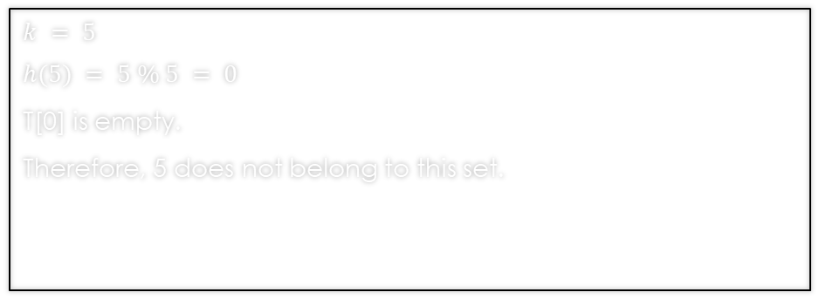
Q1: Describe changes to hash set
Operations:
>Check whether 5 belongs to this set_
Work Area:
Hash Set:
$$k = 5$$
$$h(5) = 5 \% 5 = 0$$
T[0] is empty.
Therefore, 5 does not belong to this set.
T[0]
NULL
T[1]
NULL
T[2]
NULL
T[3]
NULL
T[4]
NULL

Slide 7
Q1: Describe changes to hash set
Operations:
>Add 5 to this set_
Work Area:
Hash Set:
T[0]
NULL
T[1]
NULL
T[2]
NULL
T[3]
NULL
T[4]
NULL

Slide 8
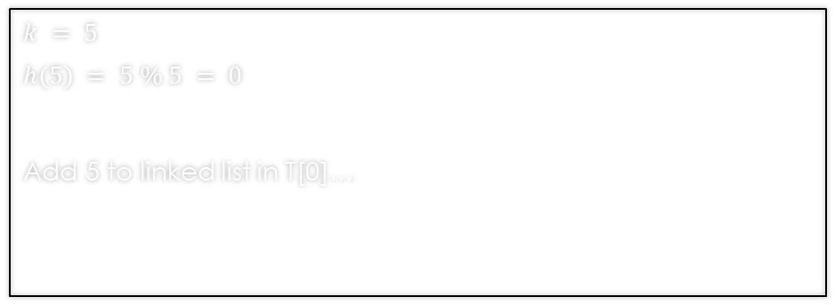
Q1: Describe changes to hash set
Operations:
>Add 5 to this set_
Work Area:
Hash Set:
$$k = 5$$
$$h(5) = 5 \% 5 = 0$$
Add 5 to linked list in T[0]…
T[0]
NULL
T[1]
NULL
T[2]
NULL
T[3]
NULL
T[4]
NULL

Slide 9
Q1: Describe changes to hash set
Operations:
>Add 5 to this set_
Work Area:
*Hash Set:
$$k = 5$$
$$h(5) = 5 \% 5 = 0$$
Add 5 to linked list in T[0]…
T[0]
5
T[1]
NULL
T[2]
NULL
T[3]
NULL
T[4]
NULL

Slide 10
Q1: Describe changes to hash set
Operations:
>Add 3 to this set_
Work Area:
Hash Set:
T[0]
5
T[1]
NULL
T[2]
NULL
T[3]
NULL
T[4]
NULL

Slide 11
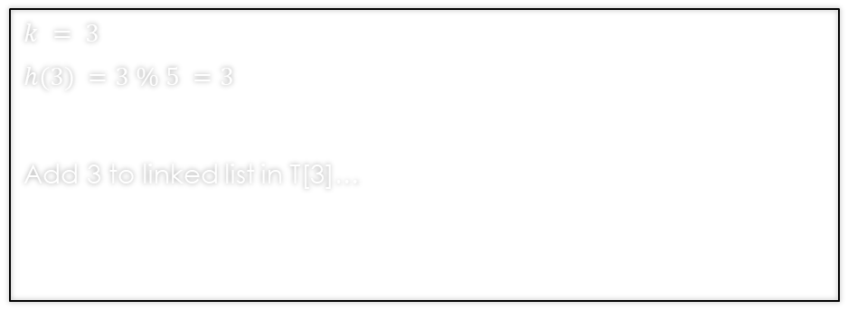
Q1: Describe changes to hash set
Operations:
>Add 3 to this set_
Work Area:
Hash Set:
$$k = 3$$
$$h(3) =3 \% 5 =3$$
Add 3 to linked list in T[3]…
T[0]
5
T[1]
NULL
T[2]
NULL
T[3]
NULL
T[4]
NULL

Slide 12
Q1: Describe changes to hash set
Operations:
>Add 3 to this set_
Work Area:
*Hash Set:
$$k = 3$$
$$h(3) =3 \% 5 =3$$
Add 3 to linked list in T[3]…
T[0]
5
T[1]
NULL
T[2]
NULL
T[3]
3
T[4]
NULL

Slide 13
Q1: Describe changes to hash set
Operations:
>Check whether 3 belongs to this set_
Work Area:
Hash Set:
T[0]
5
T[1]
NULL
T[2]
NULL
T[3]
3
T[4]
NULL

Slide 14
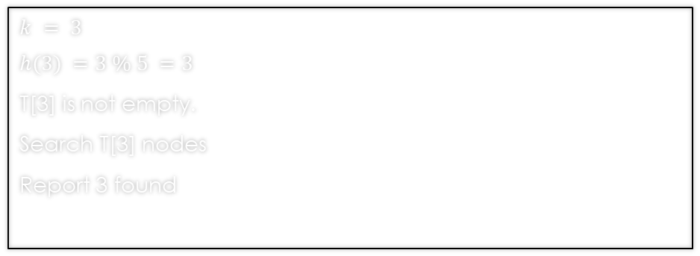
Q1: Describe changes to hash set
Operations:
>Check whether 3 belongs to this set_
Work Area:
Hash Set:
$$k = 3$$
$$h(3) =3 \% 5 =3$$
T[3] is not empty.
Search T[3] nodes
Report 3 found
T[0]
5
T[1]
NULL
T[2]
NULL
T[3]
3
T[4]
NULL

Slide 15
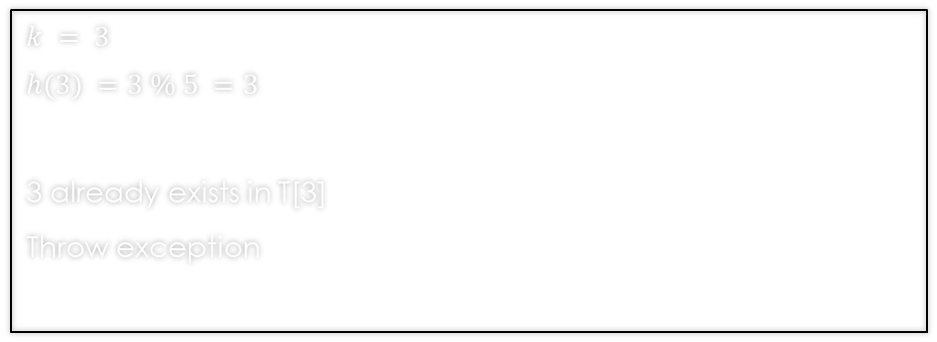
Q1: Describe changes to hash set
Operations:
>Add 3 to this set_
Work Area:
Hash Set:
$$k = 3$$
$$h(3) =3 \% 5 =3$$
3 already exists in T[3]
Throw exception
T[0]
5
T[1]
NULL
T[2]
NULL
T[3]
3
T[4]
NULL

Slide 16
Q1: Describe changes to hash set
Operations:
>Check whether 3 belongs to this set_
Work Area:
Hash Set:
T[0]
5
T[1]
NULL
T[2]
NULL
T[3]
3
T[4]
NULL

Slide 17
Q1: Describe changes to hash set
Operations:
>Check whether 3 belongs to this set_
Work Area:
Hash Set:
$$k = 3$$
$$h(3) =3 \% 5 =3$$
T[3] is not empty.
Search T[3] nodes
Report 3 found
T[0]
5
T[1]
NULL
T[2]
NULL
T[3]
3
T[4]
NULL

Slide 18
Q1: Describe changes to hash set
Operations:
>Add 7 to this set_
Work Area:
Hash Set:
T[0]
5
T[1]
NULL
T[2]
NULL
T[3]
3
T[4]
NULL

Slide 19
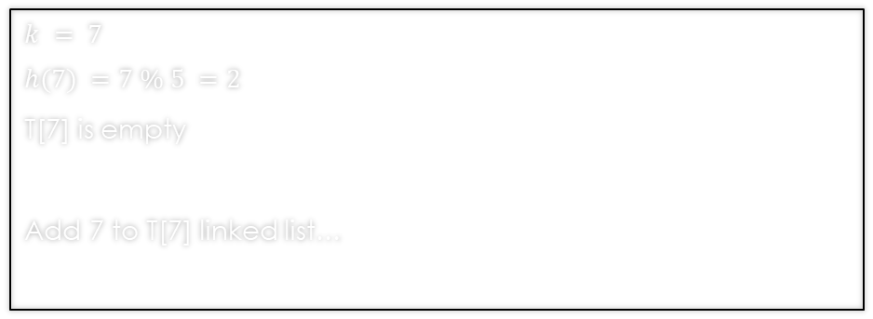
Q1: Describe changes to hash set
Operations:
>Add 7 to this set_
Work Area:
Hash Set:
$$k = 7$$
$$h(7) =7 \% 5 =2$$
T[7] is empty
Add 7 to T[7] linked list…
T[0]
5
T[1]
NULL
T[2]
NULL
T[3]
3
T[4]
NULL

Slide 20
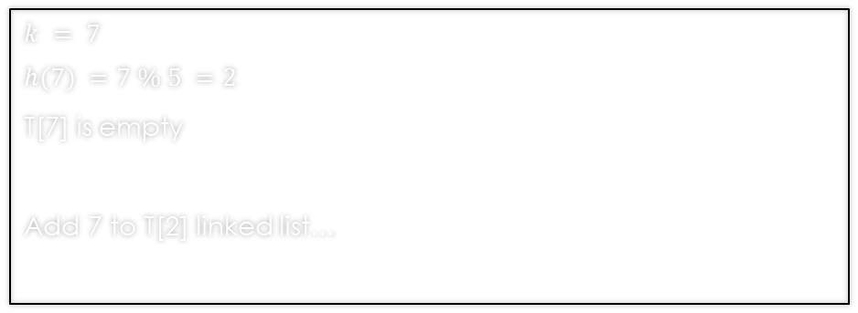
Q1: Describe changes to hash set
Operations:
>Add 7 to this set_
Work Area:
*Hash Set:
$$k = 7$$
$$h(7) =7 \% 5 =2$$
T[7] is empty
Add 7 to T[2] linked list…
T[0]
5
T[1]
NULL
T[2]
7
T[3]
3
T[4]
NULL

Slide 21
Q1: Describe changes to hash set
Operations:
>Check whether 7 belongs to this set_
Work Area:
Hash Set:
T[0]
5
T[1]
NULL
T[2]
7
T[3]
3
T[4]
NULL

Slide 22
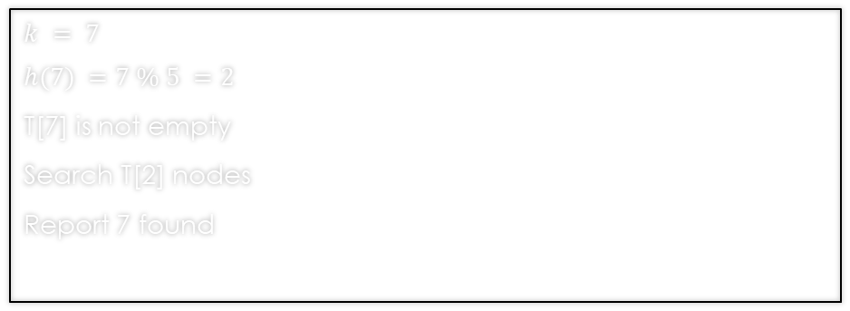
Q1: Describe changes to hash set
Operations:
>Check whether 7 belongs to this set_
Work Area:
Hash Set:
$$k = 7$$
$$h(7) =7 \% 5 =2$$
T[7] is not empty
Search T[2] nodes
Report 7 found
T[0]
5
T[1]
NULL
T[2]
7
T[3]
3
T[4]
NULL

Slide 23
Q1: Describe changes to hash set
Operations:
>Check whether 7 belongs to this set_
Work Area:
Hash Set:
$$k = 7$$
$$h(7) =7 \% 5 =2$$
T[7] is not empty
Search T[2] nodes
Report 7 found
T[0]
5
T[1]
NULL
T[2]
7
T[3]
3
T[4]
NULL

Slide 24
Q1: Describe changes to hash set
Operations:
>Check whether 4 belongs to this set_
Work Area:
Hash Set:
T[0]
5
T[1]
NULL
T[2]
7
T[3]
3
T[4]
NULL

Slide 25
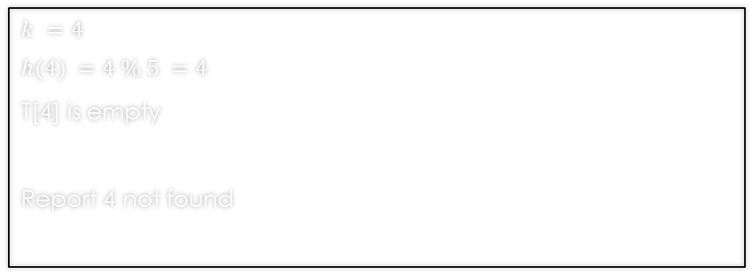
Q1: Describe changes to hash set
Operations:
>Check whether 4 belongs to this set_
Work Area:
Hash Set:
$$k =4$$
$$h(4) =4 \% 5 =4$$
T[4] is empty
Report 4 not found
T[0]
5
T[1]
NULL
T[2]
7
T[3]
3
T[4]
NULL

Slide 26
Q1: Describe changes to hash set
Operations:
>Add 1 to this set_
Work Area:
Hash Set:
T[0]
5
T[1]
NULL
T[2]
7
T[3]
3
T[4]
NULL

Slide 27
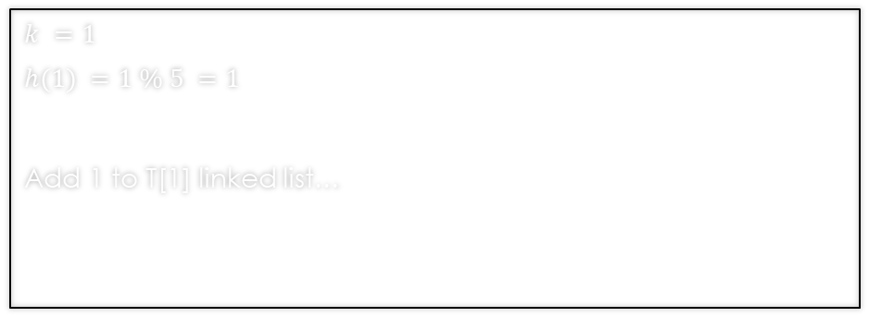
Q1: Describe changes to hash set
Operations:
>Add 1 to this set_
Work Area:
Hash Set:
$$k =1$$
$$h(1) =1 \% 5 =1$$
Add 1 to T[1] linked list…
T[0]
5
T[1]
NULL
T[2]
7
T[3]
3
T[4]
NULL

Slide 28
Q1: Describe changes to hash set
Operations:
>Add 1 to this set_
Work Area:
*Hash Set:
$$k =1$$
$$h(1) =1 \% 5 =1$$
Add 1 to T[1] linked list…
T[0]
5
T[1]
1
T[2]
7
T[3]
3
T[4]
NULL

Slide 29
Q1: Describe changes to hash set
Operations:
>Add 4 to this set_
Work Area:
Hash Set:
T[0]
5
T[1]
1
T[2]
7
T[3]
3
T[4]
NULL

Slide 30
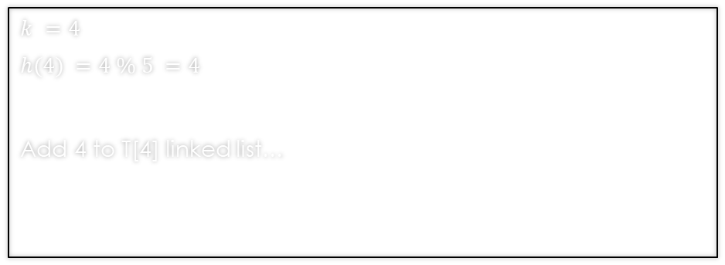
Q1: Describe changes to hash set
Operations:
>Add 4 to this set_
Work Area:
Hash Set:
$$k =4$$
$$h(4) =4 \% 5 =4$$
Add 4 to T[4] linked list…
T[0]
5
T[1]
1
T[2]
7
T[3]
3
T[4]
NULL

Slide 31
Q1: Describe changes to hash set
Operations:
>Add 4 to this set_
Work Area:
*Hash Set:
$$k =4$$
$$h(4) =4 \% 5 =4$$
Add 4 to T[4] linked list…
T[0]
5
T[1]
1
T[2]
7
T[3]
3
T[4]
4

Slide 32
Q1: Describe changes to hash set
Operations:
>Add 6 to this set_
Work Area:
Hash Set:
T[0]
5
T[1]
1
T[2]
7
T[3]
3
T[4]
4

Slide 33
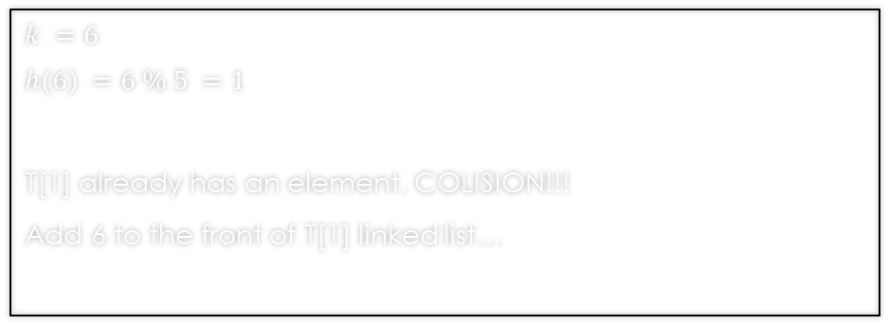
Q1: Describe changes to hash set
Operations:
>Add 6 to this set_
Work Area:
Hash Set:
$$k =6$$
$$h(6) =6 \% 5 =1$$
T[1] already has an element. COLISION!!!
Add 6 to the front of T[1] linked list…
T[0]
5
T[1]
1
T[2]
7
T[3]
3
T[4]
4

Slide 34
Q1: Describe changes to hash set
Operations:
>Add 6 to this set_
Work Area:
*Hash Set:
$$k =6$$
$$h(6) =6 \% 5 =1$$
T[1] already has an element. COLISION!!!
Add 6 to the front of T[1] linked list…
T[0]
5
T[1]
6
1
T[2]
7
T[3]
3
T[4]
4

Slide 35
Q1: Describe changes to hash set
Operations:
>_
Work Area:
Hash Set:
T[0]
5
T[1]
6
1
T[2]
7
T[3]
3
T[4]
4

Slide 36
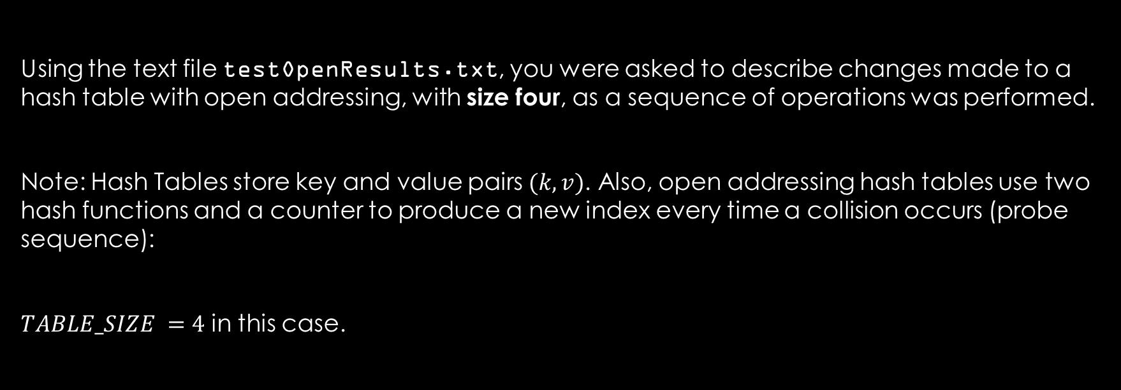
Q2: Describe changes to open addressing hash table
Using the text file testOpenResults.txt, you were asked to describe changes made to a hash table with open addressing, with size four, as a sequence of operations was performed.
Note: Hash Tables store key and value pairs $(k, v)$. Also, open addressing hash tables use two hash functions and a counter to produce a new index every time a collision occurs (probe sequence):
$TABLE_SIZE =4$ in this case.

Slide 37
Q2: Describe changes to open addressing hash table
Operations:
>Create a hash table with size 4_
Work Area:
Hash Table:

Slide 38
Q2: Describe changes to open addressing hash table
Operations:
>Create a hash table with size 4_
Work Area:
Hash Table:
T[0]
NULL
T[1]
NULL
T[2]
NULL
T[3]
NULL

Slide 39
Q2: Describe changes to open addressing hash table
Operations:
>Check whether a value is defined for 5_
Work Area:
Hash Table:
T[0]
NULL
T[1]
NULL
T[2]
NULL
T[3]
NULL

Slide 40
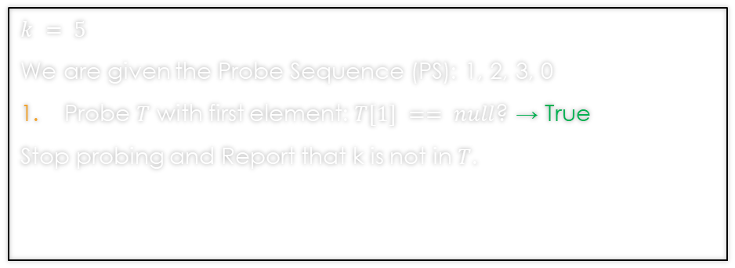
Q2: Describe changes to open addressing hash table
Operations:
>Check whether a value is defined for 5_
Work Area:
Hash Table:
$$k = 5$$
We are given the Probe Sequence (PS): 1, 2, 3, 0
Probe $T$ with first element: $T[1] == null$? → True
Stop probing and Report that k is not in $T$.
T[0]
NULL
T[1]
NULL
T[2]
NULL
T[3]
NULL

Slide 41
Q2: Describe changes to open addressing hash table
Operations:
>Search for 5_
Work Area:
Hash Table:
T[0]
NULL
T[1]
NULL
T[2]
NULL
T[3]
NULL

Slide 42
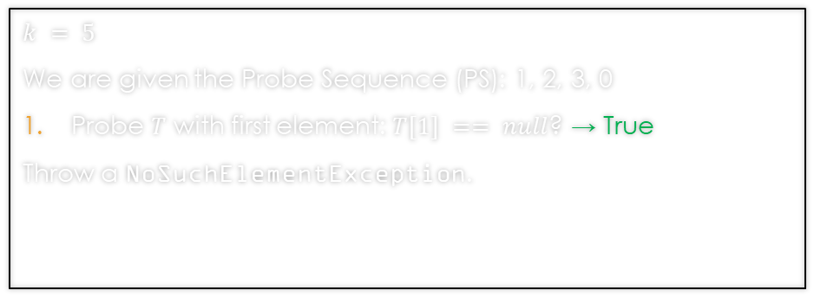
Q2: Describe changes to open addressing hash table
Operations:
>Search for 5_
Work Area:
Hash Table:
$$k = 5$$
We are given the Probe Sequence (PS): 1, 2, 3, 0
Probe $T$ with first element: $T[1] == null$? → True
Throw a NoSuchElementException.
T[0]
NULL
T[1]
NULL
T[2]
NULL
T[3]
NULL

Slide 43
Q2: Describe changes to open addressing hash table
Operations:
>Set the value defined for 5 to be "cinq"_
Work Area:
Hash Table:
T[0]
NULL
T[1]
NULL
T[2]
NULL
T[3]
NULL

Slide 44
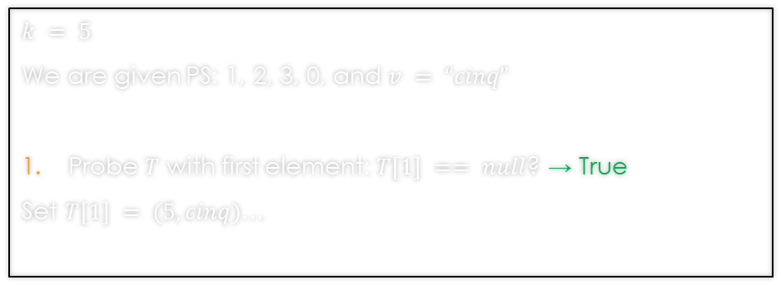
Q2: Describe changes to open addressing hash table
Operations:
>Set the value defined for 5 to be "cinq"_
Work Area:
Hash Table:
$$k = 5$$
We are given PS: 1, 2, 3, 0, and $v = “cinq”$
Probe $T$ with first element: $T[1] == null$? → True
Set $T[1] = (5, cinq)$…
T[0]
NULL
T[1]
NULL
T[2]
NULL
T[3]
NULL

Slide 45
Q2: Describe changes to open addressing hash table
Operations:
>Set the value defined for 5 to be "cinq"_
Work Area:
*Hash Table:
$$k = 5$$
We are given PS: 1, 2, 3, 0, and $v = “cinq”$
Probe $T$ with first element: $T[1] == null$? → True
Set $T[1] = (5, cinq)$…
T[0]
NULL
T[1]
(5,cinq)
T[2]
NULL
T[3]
NULL

Slide 46
Q2: Describe changes to open addressing hash table
Operations:
>Set the value defined for 3 to be "troix"_
Work Area:
Hash Table:
T[0]
NULL
T[1]
(5,cinq)
T[2]
NULL
T[3]
NULL

Slide 47
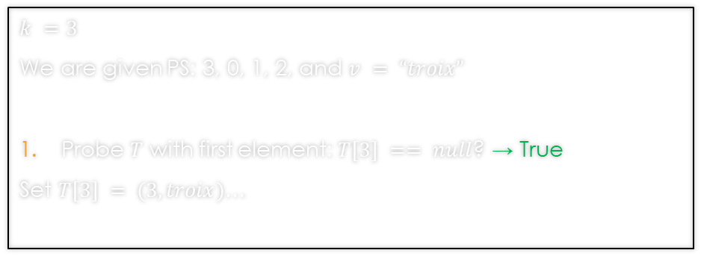
Q2: Describe changes to open addressing hash table
Operations:
>Set the value defined for 3 to be "troix"_
Work Area:
Hash Table:
$$k =3$$
We are given PS: 3, 0, 1, 2, and $v = “troix”$
Probe $T$ with first element: $T[3] == null$? → True
Set $T[3] = (3,troix)$…
T[0]
NULL
T[1]
(5,cinq)
T[2]
NULL
T[3]
NULL

Slide 48
Q2: Describe changes to open addressing hash table
Operations:
>Set the value defined for 3 to be "troix"_
Work Area:
*Hash Table:
$$k =3$$
We are given PS: 3, 0, 1, 2, and $v = “troix”$
Probe $T$ with first element: $T[3] == null$? → True
Set $T[3] = (3,troix)$…
T[0]
NULL
T[1]
(5,cinq)
T[2]
NULL
T[3]
(3,troix)

Slide 49
Q2: Describe changes to open addressing hash table
Operations:
>Search for 3_
Work Area:
Hash Table:
T[0]
NULL
T[1]
(5,cinq)
T[2]
NULL
T[3]
(3,troix)

Slide 50
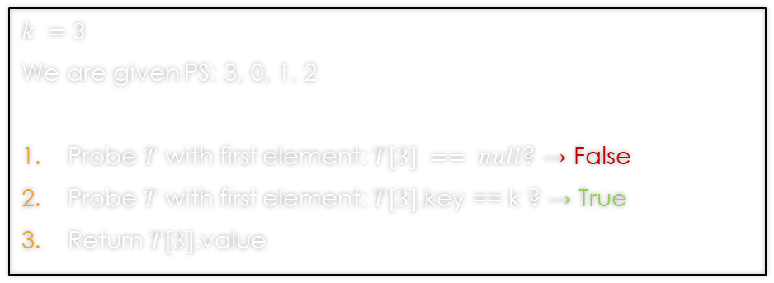
Q2: Describe changes to open addressing hash table
Operations:
>Search for 3_
Work Area:
Hash Table:
$$k =3$$
We are given PS: 3, 0, 1, 2
Probe $T$ with first element: $T[3] == null$? → False
Probe $T$ with first element: $T[3]$.key == k ? → True
Return $T[3]$.value
T[0]
NULL
T[1]
(5,cinq)
T[2]
NULL
T[3]
(3,troix)

Slide 51
Q2: Describe changes to open addressing hash table
Operations:
>Set the value defined for 3 to be “trois”_
Work Area:
Hash Table:
T[0]
NULL
T[1]
(5,cinq)
T[2]
NULL
T[3]
(3,troix)

Slide 52
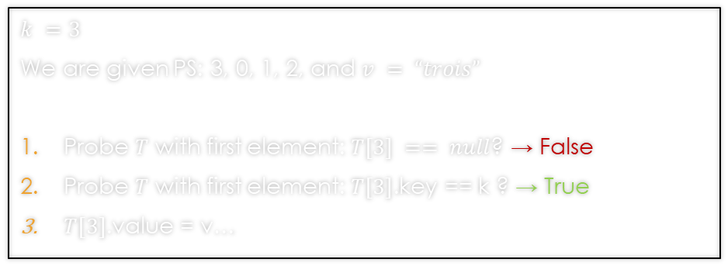
Q2: Describe changes to open addressing hash table
Operations:
>Set the value defined for 3 to be “trois”_
Work Area:
Hash Table:
$$k =3$$
We are given PS: 3, 0, 1, 2, and $v = “trois”$
Probe $T$ with first element: $T[3] == null$? → False
Probe $T$ with first element: $T[3]$.key == k ? → True
$T[3]$.value = v…
T[0]
NULL
T[1]
(5,cinq)
T[2]
NULL
T[3]
(3,troix)

Slide 53
Q2: Describe changes to open addressing hash table
Operations:
>Set the value defined for 3 to be “trois”_
Work Area:
*Hash Table:
$$k =3$$
We are given PS: 3, 0, 1, 2, and $v = “trois”$
Probe $T$ with first element: $T[3] == null$? → False
Probe $T$ with first element: $T[3]$.key == k ? → True
$T[3]$.value = v…
T[0]
NULL
T[1]
(5,cinq)
T[2]
NULL
T[3]
(3,trois)

Slide 54
Q2: Describe changes to open addressing hash table
Operations:
>Search for 3_
Work Area:
Hash Table:
T[0]
NULL
T[1]
(5,cinq)
T[2]
NULL
T[3]
(3,trois)

Slide 55
Q2: Describe changes to open addressing hash table
Operations:
>Search for 3_
Work Area:
Hash Table:
$$k =3$$
We are given PS: 3, 0, 1, 2
Probe $T$ with first element: $T[3] == null$? → False
Probe $T$ with first element: $T[3]$.key == k ? → True
Return $T[3]$.value
T[0]
NULL
T[1]
(5,cinq)
T[2]
NULL
T[3]
(3,trois)

Slide 56
Q2: Describe changes to open addressing hash table
Operations:
>Set the value defined for 7 to be “sept”_
Work Area:
Hash Table:
T[0]
NULL
T[1]
(5,cinq)
T[2]
NULL
T[3]
(3,trois)

Slide 57
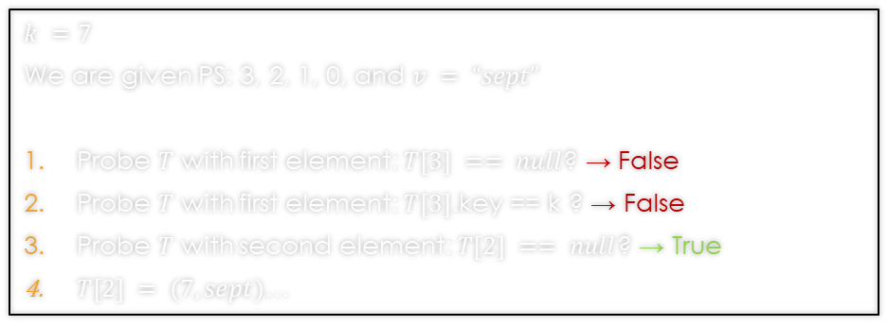
Q2: Describe changes to open addressing hash table
Operations:
>Set the value defined for 7 to be “sept”_
Work Area:
Hash Table:
$$k =7$$
We are given PS: 3, 2, 1, 0, and $v = “sept”$
Probe $T$ with first element: $T[3] == null$? → False
Probe $T$ with first element: $T[3]$.key == k ? → False
Probe $T$ with second element: $T[2] == null$? → True
$T[2] = (7, sept)$…
T[0]
NULL
T[1]
(5,cinq)
T[2]
(7,sept)
T[3]
(3,trois)

Slide 58
Q2: Describe changes to open addressing hash table
Operations:
>Check whether a value is defined for 7_
Work Area:
Hash Table:
T[0]
NULL
T[1]
(5,cinq)
T[2]
(7,sept)
T[3]
(3,trois)

Slide 59
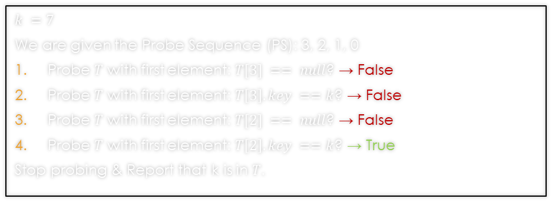
Q2: Describe changes to open addressing hash table
Operations:
>Check whether a value is defined for 7_
Work Area:
Hash Table:
$$k =7$$
We are given the Probe Sequence (PS): 3, 2, 1, 0
Probe $T$ with first element: $T[3] == null$? → False
Probe $T$ with first element: $T\left[3\right].key ==k$? → False
Probe $T$ with first element: $T[2] == null$? → False
Probe $T$ with first element: $T\left[2\right].key ==k$? → True
Stop probing & Report that k is in $T$.
T[0]
NULL
T[1]
(5,cinq)
T[2]
(7,sept)
T[3]
(3,trois)

Slide 60
Q2: Describe changes to open addressing hash table
Operations:
>Check whether a value is defined for 4_
Work Area:
Hash Table:
T[0]
NULL
T[1]
(5,cinq)
T[2]
(7,sept)
T[3]
(3,trois)

Slide 61
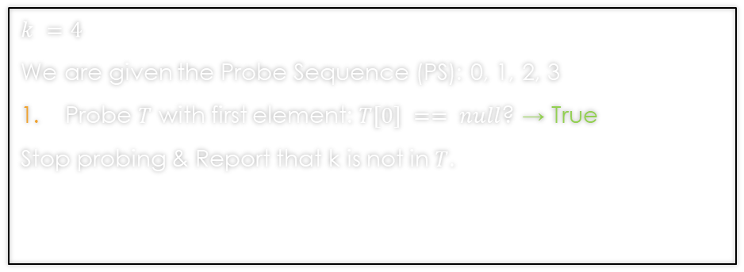
Q2: Describe changes to open addressing hash table
Operations:
>Check whether a value is defined for 4_
Work Area:
Hash Table:
$$k =4$$
We are given the Probe Sequence (PS): 0, 1, 2, 3
Probe $T$ with first element: $T[0] == null$? → True
Stop probing & Report that k is not in $T$.
T[0]
NULL
T[1]
(5,cinq)
T[2]
(7,sept)
T[3]
(3,trois)

Slide 62
Q2: Describe changes to open addressing hash table
Operations:
>Set the value defined for 1 to be "un"_
Work Area:
Hash Table:
T[0]
NULL
T[1]
(5,cinq)
T[2]
(7,sept)
T[3]
(3,trois)

Slide 63
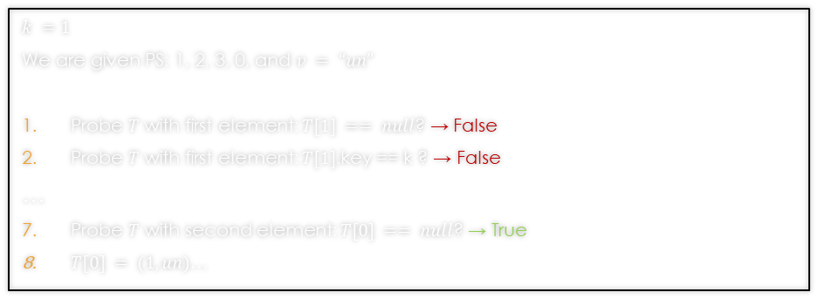
Q2: Describe changes to open addressing hash table
Operations:
>Set the value defined for 1 to be "un"_
Work Area:
Hash Table:
$$k =1$$
We are given PS: 1, 2, 3, 0, and $v = “un”$
Probe $T$ with first element: $T[1] == null$? → False
Probe $T$ with first element: $T[1]$.key == k ? → False
…
Probe $T$ with second element: $T[0] == null$? → True
$T[0] = (1, un)$…
T[0]
NULL
T[1]
(5,cinq)
T[2]
(7,sept)
T[3]
(3,trois)

Slide 64
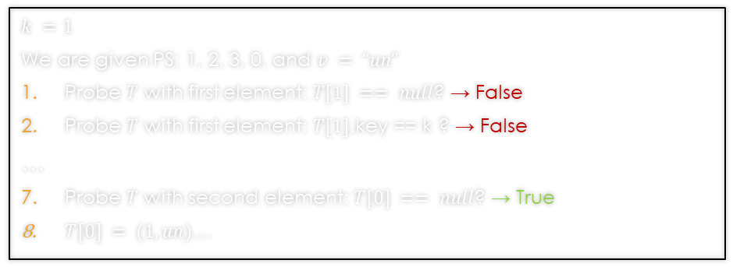
Q2: Describe changes to open addressing hash table
Operations:
>Set the value defined for 1 to be "un"_
Work Area:
*Hash Table:
$$k =1$$
We are given PS: 1, 2, 3, 0, and $v = “un”$
Probe $T$ with first element: $T[1] == null$? → False
Probe $T$ with first element: $T[1]$.key == k ? → False
…
Probe $T$ with second element: $T[0] == null$? → True
$T[0] = (1, un)$…
T[0]
(1,un)
T[1]
(5,cinq)
T[2]
(7,sept)
T[3]
(3,trois)

Slide 65
Q2: Describe changes to open addressing hash table
Operations:
>Set the value defined for 4 to be "quatre"_
Work Area:
Hash Table:
T[0]
(1,un)
T[1]
(5,cinq)
T[2]
(7,sept)
T[3]
(3,trois)

Slide 66
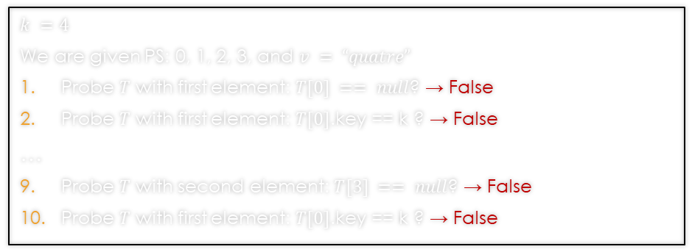
Q2: Describe changes to open addressing hash table
Operations:
>Set the value defined for 4 to be "quatre"_
Work Area:
Hash Table:
$$k =4$$
We are given PS: 0, 1, 2, 3, and $v = “quatre”$
Probe $T$ with first element: $T[0] == null$? → False
Probe $T$ with first element: $T[0]$.key == k ? → False
…
Probe $T$ with second element: $T[3] == null$? → False
Probe $T$ with first element: $T[0]$.key == k ? → False
T[0]
(1,un)
T[1]
(5,cinq)
T[2]
(7,sept)
T[3]
(3,trois)

Slide 67
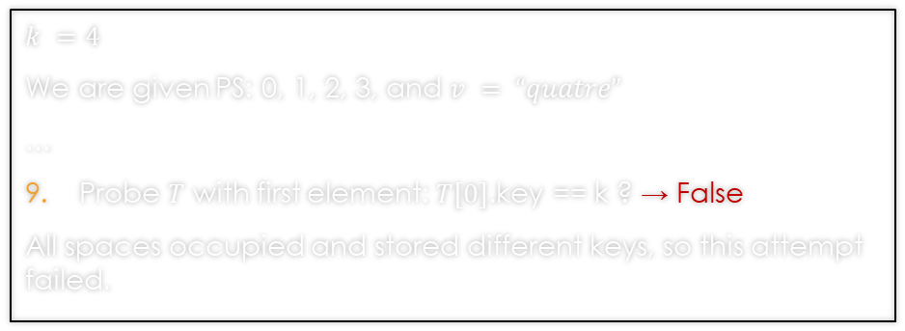
Q2: Describe changes to open addressing hash table
Operations:
>Set the value defined for 4 to be "quatre"_
Work Area:
Hash Table:
$$k =4$$
We are given PS: 0, 1, 2, 3, and $v = “quatre”$
…
Probe $T$ with first element: $T[0]$.key == k ? → False
All spaces occupied and stored different keys, so this attempt failed.
T[0]
(1,un)
T[1]
(5,cinq)
T[2]
(7,sept)
T[3]
(3,trois)

Slide 68
Q3: upper bound on total num. of probes
Give an upper bound on the total number of probes used by the rehash algorithm in the worst case.

Slide 69
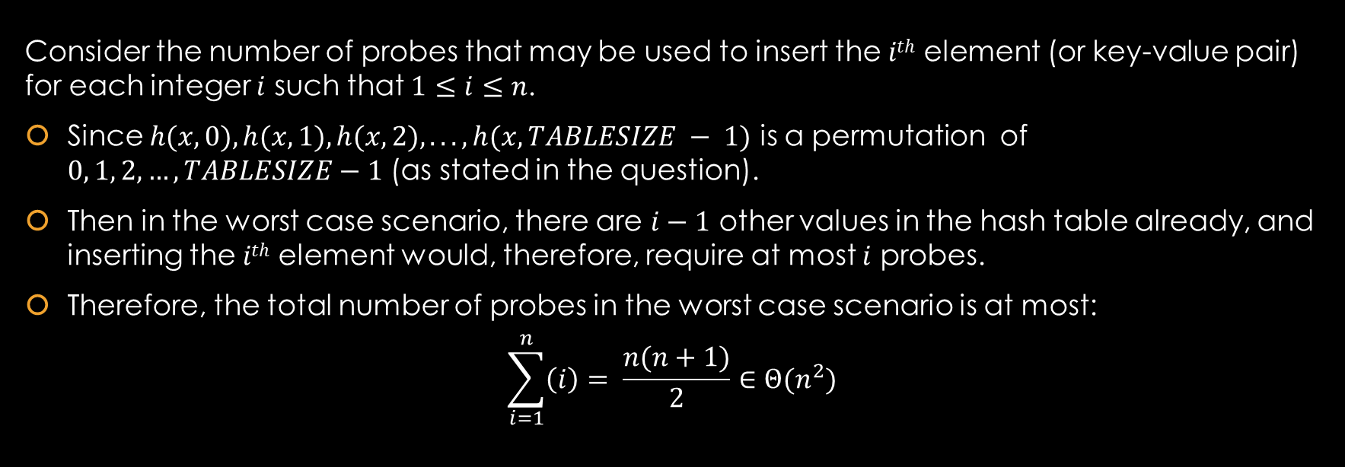
Q3: upper bound on total num. of probes
Consider the number of probes that may be used to insert the $ith$ element (or key-value pair) for each integer $i$ such that $1≤i≤n$.
Since $h(x, 0), h(x, 1), h(x, 2), . . . , h(x, TABLESIZE − 1)$ is a permutation of $0, 1, 2, …, TABLESIZE−1$ (as stated in the question).
Then in the worst case scenario, there are $i−1$ other values in the hash table already, and inserting the $ith$ element would, therefore, require at most $i$ probes.
Therefore, the total number of probes in the worst case scenario is at most:
$$\sum_{i=1}^{n}{\left(i\right)= \frac{n(n+1)}{2}}∈Θ(n^{2})$$

